Slide 1
The Constitution
Chapter 3

Slide 2
Basic Principles of the Constitution

Slide 3
This idea has expanded over time by amendments to the Constitution.
Originally the Constitution only allowed citizens to vote for members of the House of Representatives.
Notes:
The 15th (extending voting rights to African Americans), 19th (extended voting rights to women), 26th
The State Legislatures voted for President, judges, or senators (17th amendment extended this right to citizens).
The framers of the Constitution wanted to guard against tyranny of the masses, so they left things in the hands of the state legislatures.
This also will helped to pass the Constitution, by keeping power in the states.
The right to vote was left up to each state to decide, the states extended voting rights well before the federal government did because of the desire of their citizens to vote.

Slide 4
1. Popular Sovereignty
The fundamental principle that the power to govern belongs to the people and that government must be based on the consent of the governed.
Notes:
The Constitution paid almost no attention to social equality and hardly mentioned slavery.

Slide 5
2. Separation of Powers
The division of government’s executive, legislative, and judicial powers into three separate branches.
Many people felt that the Articles of Confederation failed because there wasn’t checks on power.
As a result separation of powers became a basic principle of government
Notes:
Separation of powers wasn’t a new idea in 1787, it had been used in the colonies for over 100 years.

Slide 6
Executive Branch
The President
Executive office of the President; executive and cabinet departments; independent government agencies
The Congress
House of Representatives; Senate.
House and Senate can veto each others bills
The Courts
Supreme Court; Court of Appeals; District Courts
Judicial Branch
Legislative Branch

Slide 7
3. Checks and Balances
A system in which political power is divided among the three branches of government, with each having some control over the others.
“Ambition must be made to counteract ambition” – Madison The Federalist No. 51

Slide 8
Executive Branch
Can declare Presidential acts unconstitutional
President can veto bills
Congress approves Presidential nominees, controls the budget, can over ride a veto, and can impeach the President
President nominates Judges
The Senate confirms the President’s nominations, Congress can impeach Judges and remove them from office.
Judicial Branch
Legislative Branch
The courts can declare presidential acts unconstitutional

Slide 9
4. Limited Government
“Ambition must be made to counteract ambition” – Madison The Federalist No. 51
Reflects the Framers concern about the oppression by rulers and a fear of tyranny of the majority.

Slide 10
5. Federalism
The division of governmental power, as expressed in the Unite States Constitution between the national government and the states.
Reflects the Founders’ desire to balance liberty and order.

Slide 11
Structure of the Constitution

Slide 12
The Constitution provides a basic outline for our government.
It doesn’t go into great detail.
It is divided into three parts
The Preamble
The Articles
The Amendments

Slide 13
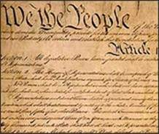
The Preamble
Lists six goals for American government
To form a more perfect union
Establish justice
Insure domestic tranquility (peace)
Provide for the common defense
Promote the general welfare
Secure the blessings of liberty

Slide 14
The Articles
There are 7 articles in the constitution
Article I – Legislative Branch
Article II – Executive Branch
Article III – Judicial Branch

Slide 15
Amendments
Amendment – a formal statement of change to a law or constitution.
There are 27 amendments to the Constitution
The amendments deal with a variety of issues.

Slide 16
Lame Duck – an elected official during the period between failure to win re-election and the inauguration of a successor

Slide 17
The Bill of Rights
The first 10 amendments to the Constitution.
Added in 1791
Was added to prevent the national government from limiting personal freedoms.
Notes:
These were a promise made by Federalists in order to help pass the constitution, among the states
They were passed by the first Congress
12 were originally proposed, but only 10 were approved by the states.
One of those 12 was later made the 27th amendment (about congressional pay)

Slide 18
The Amendment Process

Slide 19
The Formal Amendment Process
Found in Article V
There are four different paths a proposed amendment can take.
Congress decides the method and sets a time limit (7 years).

Slide 20
Two Ways to Propose Amendments
1. Proposed by 2/3 vote of each house of Congress
2. Proposed by a national constitutional convention requested by at least 2/3 of state legislatures
Two Ways to Ratify Amendments
1. Ratified by at least 3/4 of the state legislatures
2. Ratified by specially called conventions in at least 3/4 of the states

Slide 21
The Informal Amendment Process
The Constitution was written rather broadly so that changes could happen with the political system without having to go through the formal process.

Slide 22
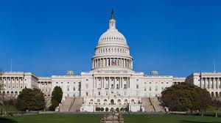
1. Legislative Actions
Congress has passed many laws that spell out and add to the Constitution’s provisions.
Examples
Taxes
Federal Courts
Notes:
Power to “lay and collect taxes” Article 1 Sec. 8 → Doesn’t specify how much in taxes should be collected
“one Supreme Court, and … such inferior courts as the Congress may form time to time ordain and establish” Article 3 Sec. 1 → set up federal courts

Slide 23
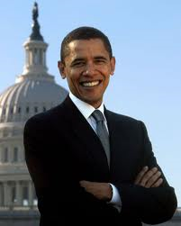
2. Executive Actions
The way that the President carries out the laws made by congress has also shaped the way that the Constitution is interrupted.
Notes:
Example: The President can wage war without having Congress declare it

Slide 24
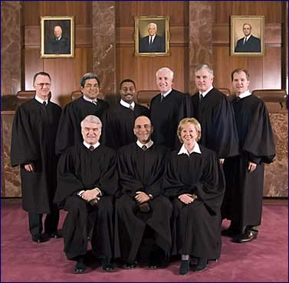
3. Judicial Interpretations
The courts ensure that the laws passed by the state and national government fall in line with the constitution.
Notes:
The power of the courts was enhanced in the 1803 case of Marbury v. Madison, in which the court gave itself the power of judicial review

Slide 25
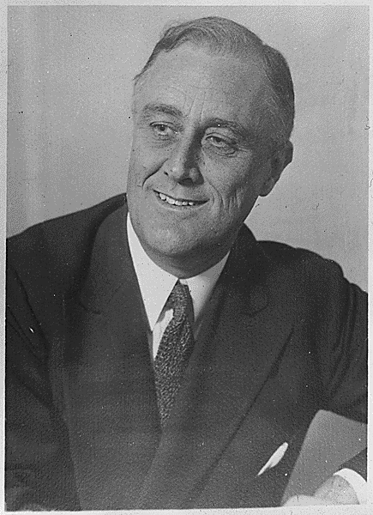
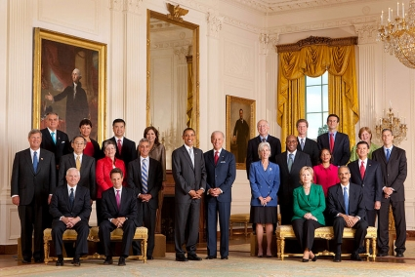
4. Changing Customs
Many unwritten customs have become accepted as constitutional even though they aren’t apart of the constitution.
Example:
Presidential 2 terms in office – customary for 150 years
Presidential cabinet

