Slide 1
The Structure of the Atom
Chapter 4

Slide 2
Early Ideas About Matter
Section 1

Slide 3
The Greeks
The Greeks were the first to try and explain why chemical changes occur.
They believed that all matter was composed of four fundamental substances: fire, earth, water & air

Slide 4
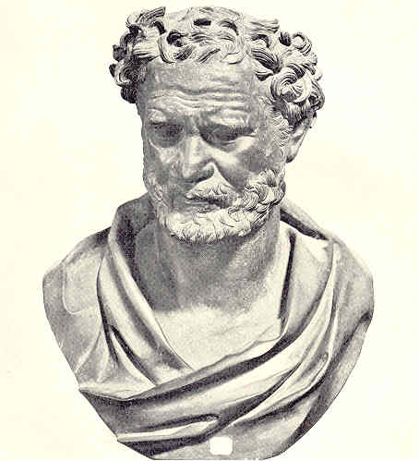
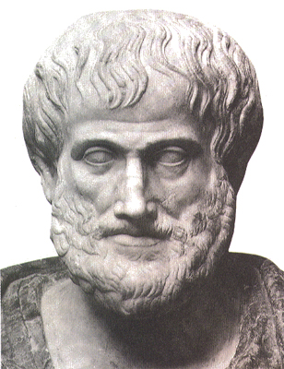
Ancient Greek Ideas About Matter
Democritus
Aristotle
Matter is composed of atoms, which move through empty space.
Atoms are solid, homogenous, indestructible, & indivisible.
Different kinds of atoms have different sizes & shapes
Size, shape, & movement of atoms determine the properties of matter.
Empty space cannot exist.
Matter is made of earth, fire, air, & water.

Slide 5
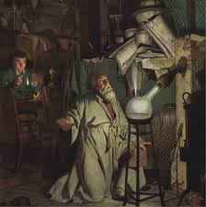
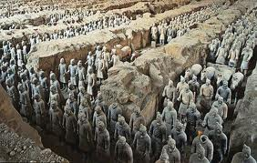
The Idea of the Atom Didn’t Significantly Change over the Next 2000 years.
The next 2000 years of history were dominated by alchemy.
Some alchemists were mystics and fakes but the vast majority were scientists.
They discovered the elements of mercury, sulfur & antimony.
They also learned how to prepare acids.

Slide 6
Dalton’s Atomic Theory
Matter is composed of extremely small particles called atoms.
Atoms are indivisible and indestructible.
All atoms of a given element are identical in size, mass, & chemical properties.
The atoms of a given element are different from those of any other element.
Different atoms combine in simple whole-number ratios to form compounds.
In a chemical reaction, atoms are separated, combined or rearranged.

Slide 7
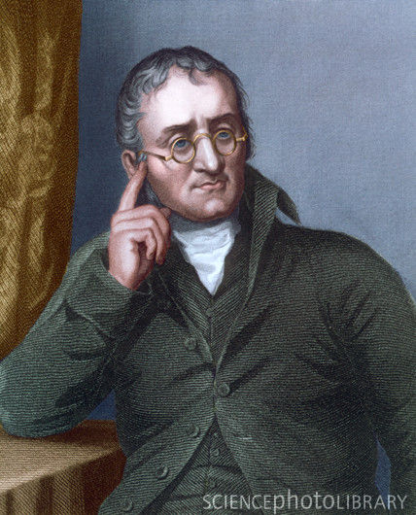
Recall the Law of Conservation of Mass…
Dalton’s atomic theory was a huge step towards our current atomic model of matter but like most theories as technology and knowledge develops the models used also develop and change.
As it turns out there were a couple of items in Dalton’s theory that aren’t quite correct.

Slide 8
Dalton’s Atomic Theory Revised
Matter is composed of extremely small particles called atoms.
Atoms are indivisible and indestructible.
All atoms of a given element are identical in size, mass, & chemical properties.

Slide 9
Defining the Atom
Section 2

Slide 10
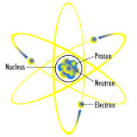
The Atom
The smallest particle of an element that retains the properties of the element.

Slide 11
The Structure of the Atom
Dalton’s atomic theory provided such a convincing explanation for the composition of compounds that it became generally accepted.
Dalton’s theory lead to many new questions
Why do atoms stick together?
What does an atom look like?

Slide 12
Thomson’s Experiment
J.J. Thomson
British, physicist
In the late 1890’s he used a cathode ray tube to show that the atoms of any element can be made to emit tiny negative particles
He knew that they had a negative charge because they were repelled by the negative part of an magnetic field
Notes:
Thomson’s Experiment - http://www.youtube.com/watch?v=O9Goyscbazk

Slide 13
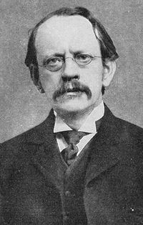
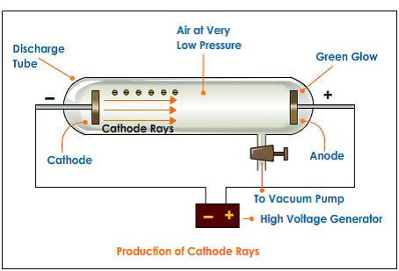

Slide 14
From this experiment, Thompson concluded that all types of atoms must contain these negative particles.
Electron's –Negatively charged particles that are part of all forms of matter.

Slide 15
New Idea’s on the Atom…
Thomson had discovered these negatively charged particles, called electrons.
But he also knew that whole atoms are not negatively or positively charged.
He concluded that the atom must also contain positive particles that balance the negative charge

Slide 16
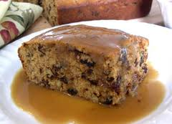
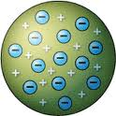
Plum Pudding Model
A pudding with raisins randomly distributed through it (Traditional British fare)
Thomson along with Lord Kelvin proposed that an atom might look like plum pudding

Slide 17
They reasoned that the atom might be thought of as a uniform “pudding” of positive charge with enough negative electrons scattered within to counterbalance the positive charge.

Slide 18
Millikan’s Oil Drop Experiment
Early 1910’s
Robert Millikan (American physicist)
Determined the charge of a single electron (1.602 x ${10}^{−19}$coulombs).
Later this charge was equated to -1
Determined the mass of an electron using the known charge-to-mass ratio.
$$Mass of an electron=9.1 x{10}^{−28}g=\frac{1}{1840}(mass of H atom)$$

Slide 19
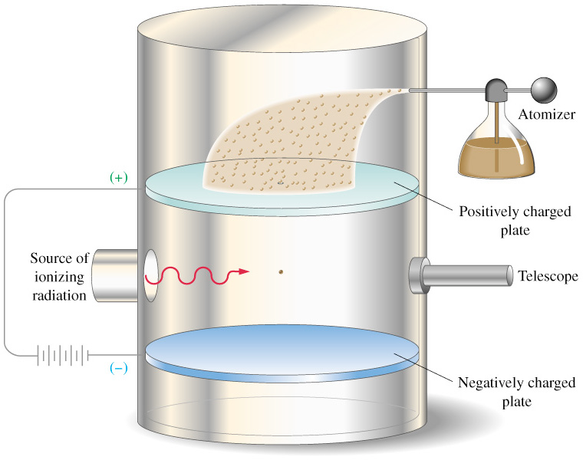

Slide 20
Rutherford’s Experiment
In 1911 Ernest Rutherford’s experiment got rid of the Plum Pudding model of the atom.
Rutherford studied alpha particles
These are positively charged particles with a mass approximately 7500 times that of an electron
Notes:
Rutherford’s Gold Foil Experiment - http://www.youtube.com/watch?v=XBqHkraf8iE

Slide 21
While studying the flight of alpha particles, he expected that all of the particles would travel in a straight line.
However, some of the alpha particles were deflected
What caused the deflection?

Slide 22
Puzzled by this observation
Rutherford designed an experiment that involved directing alpha particles towards a piece of thin gold foil
The results from the experiment were very different from what Rutherford had expected.

Slide 23
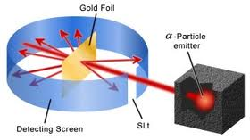
The Gold Foil Experiment
Although most of the alpha particles passed straight through the foil, some of them were deflected at large angles and others were reflected backward

Slide 24
This experiment showed that the Plum Pudding Model of the atom couldn’t be correct
The large deflection of the alpha particles showed that center of the atom must have a positive charge.

Slide 25
Rutherford’s Model of the Atom
Rutherford concluded that almost all of the atom’s positive charge and almost all of its mass were contained in a tiny dense region in the center of the atom.
He called this area the nucleus.
Because the nucleus occupies such a small space & contains most of an atom’s mass, it is incredibly dense.

Slide 26
In 1920, Rutherford had refined the concept of the nucleus and concluded that the nucleus contained positively charged particles called protons.
A proton is a subatomic particle carrying a charge equal to but opposite of an electron.
+1

Slide 27
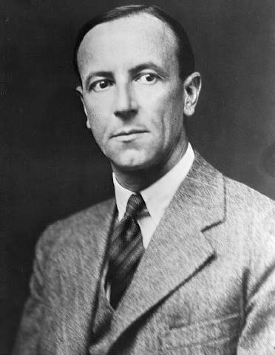
In 1932
James Chadwick (English physicist) showed that the nucleus also contained another subatomic neutral particle.
A neutron is a subatomic particle that has a mass nearly equal to that of a proton, but carries no electric charge.
In 1935 Chadwick received the Nobel Prize in Physics for this.

Slide 28
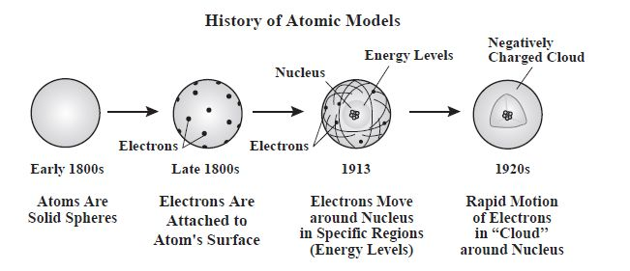

Slide 29
How Atoms Differ
Section 3

Slide 30
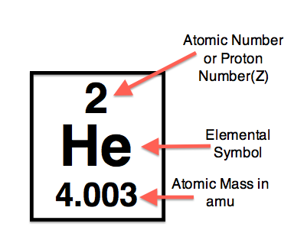
The Atomic Number
The number of protons in an atom.
The number of protons in an atom is also equal to the number of electrons

Slide 31
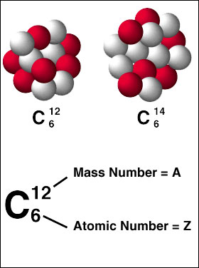
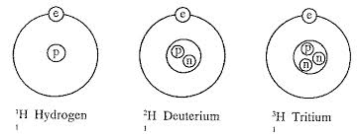
Isotopes
Atoms with the same number of protons but different numbers of neutrons.
All elements have isotopes

Slide 32
Mass Number
The sum of the atomic number (or number of protons) and neutrons in the nucleus.
Mass Number = atomic number + # of neutrons.

Slide 33
Mass of Atoms
When dealing with the masses of atoms, we are dealing with extremely small numbers.
Because of these extremely small masses are very difficult to deal with chemists have developed a method of measuring the mass of an atom relative to the mass of a specific standard.
Atomic Mass Unit (amu) – defined as one-twelfth the mass of carbon-12 atom.
1 amu is ~ equal to the mass of a single proton or a single neutron, but these values are slightly different from each other.

Slide 34
Atomic Mass
Is the weighted average mass of the isotopes of that element.
An atom’s mass depends mainly on the number of protons and neutrons it has

Slide 35
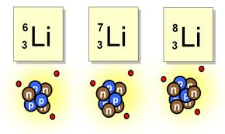
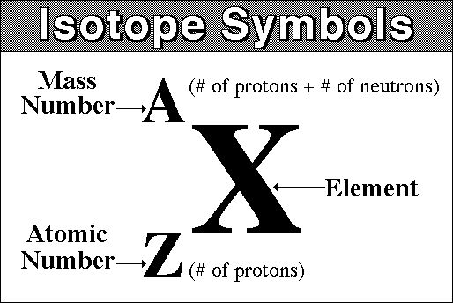

Slide 36
Unstable Nuclei & Radioactive Decay
Section 4

Slide 37
Chemical reactions involve changes in the electrons surrounding an atom.
Nuclear reactions involve changes in the nucleus of an atom.
Radioactive atoms emit radiation because their nuclei are unstable. Unstable nuclei lose energy by emitting radiation in a spontaneous process called radioactive decay.

Slide 38
Nuclear Equation
Shows the atomic numbers and mass numbers of the particles involved.

Slide 39
Alpha Beta
α
Contains 2 protons & 2 neutrons.
β
Each beta particle is an electron with -1 charge.

Slide 40
Gamma
γ
High energy radiation that posses no mass
Because they are neutral, gamma rays are not deflected by electric or magnetic fields.

