Slide 1
The Presidency

Slide 2
The Office of the President
Qualifications:
a. Natural Born Citizen
Must be born on U.S. soil
b. Must be 35 years of age or older
c. Have lived in the U.S. for 14 years

Slide 3
Natural Born Citizen
You must have been born in the United States
Military bases on foreign soil, and embassy’s are considered to be US soil as well.
Why did the framers of the Constitution require that the President be a natural born citizen?

Slide 4
Obama Controversy – 2008 Presidential Election
Some claim that his birth certificate was a forgery
Some claim he was born in Kenya
Some claim that he cannot be a natural born citizen because he had British and American citizenship at birth.
The President proved this claims to be false when he had Hawaii release his long form birth certificate.
Notes:
http://www.snopes.com/politics/obama/birthers/birthcertificate.asp

Slide 5
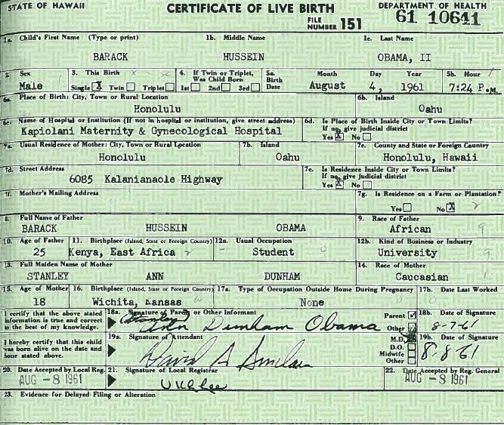
Notes:
http://www.youtube.com/watch?v=xDMk35bw-HE
http://www.youtube.com/watch?v=Blckpwk1voQ – Donald Trump Interview
http://www.youtube.com/watch?v=W0Ru7dnfSjI – Obama Birth Certificate is real

Slide 6
Age Requirement
Why does the office of the Presidency have the oldest age requirement?

Slide 7
14 years lived in the United States
In order to be President you must have lived 14 years within the United States total
Eisenhower was in Europe during WWII and elected to President 7 years after the war ended.

Slide 8
The Office of the President
Term in Office:
Elected for 4 years
Can seek one re-election
Total of 8 years as President

Slide 9
Prior to FDR (elected to 4 terms) it was customary that the President only serve 2 terms in office.
This was due to the tradition that George Washington established.

Slide 10
Write in your Constitutions…
The 22nd Amendment
Added in 1951
Set a Presidential term limit.
A president can only serve 2 terms in office
If a person succeeds to the office after the midpoint in a term, he could serve 2 more terms.
In effect, a person could serve a total of 10 years.

Slide 11
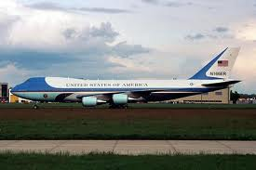
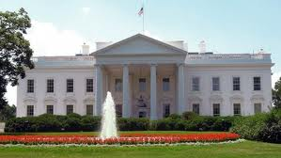
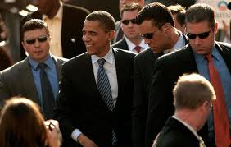
The Office of the President
Pay and Benefits:
$400,000 per year
Access to Air Force One, Marine One
Lives in the White House
Lifetime Health Care and Pension
Secret Service detail, even after leaving office
Free medical and dental care

Slide 12
A President’s lifetime pension is $191,300
Secret Service protection is provided for 10 years after leaving the office
Children have secret service protection until they are 16 years old
A Presidential widow will receive a pension of $20,000 per year

Slide 13
Hail to the chief
The duties and responsibilities of the President

Slide 14
Hail to the Chief…
The President is the Chief of State
Ceremonial head of the US

Slide 15
Chief Executive
The Constitution gives the President powers of the executive
These powers are very broad
Chief Administrator
Heads one of the largest governmental organizations in the world
More than 2.7 million people work for the US government

Slide 16
Chief Diplomat
In charge of US foreign policy
Chief representative to the world
What the President says or does is carefully followed in this country and the world
Commander in Chief of the Nations Armed Forces
1.4 million men and women subject to President’s direct and immediate control

Slide 17
Chief Legislator
Main architect of the nation’s public policy
The President initiates, suggests, requests, insists & demands the Congress enact much of the major legislation
Chief of Party
Leader of their political party
Today parties have a vital place in the workings of government

Slide 18
Chief Citizen
President is representative of the people
Place of moral leadership

Slide 19
Presidential powers

Slide 20
Presidential Powers and Leadership
Constitutional Powers: Article II of the Constitution grants executive power

Slide 21
Military Powers
Makes President Commander-in-Chief of the Armed Forces
Congress authorizes money for military forces
War Powers Act: Restricts Presidents use of troops and authorizes Congress to order troops home.
Legislative Veto: Allows Congress to void an action of the executive branch.
Found to be unconstitutional
How can this be done informally?

Slide 22
Diplomatic Powers
President is chief negotiator with foreign nations.
Senate must approve treaties
2/3 vote
Executive Agreements: Pacts between heads of state
Set tariffs (tax on imports or exports)

Slide 23
Presidential Powers and Leadership
Executive Powers
Enforce Laws
Executive Orders: A presidential directive to an agency that defines new policies.
Appointments
Reprieves, Pardons and Amnesty

Slide 24
Legislative Powers
Veto power
In order to pass a bill the President’s signature is require
If a bill is vetoed then it is sent back to the Legislature, and they can revise it or pass it with a larger majority
Line-item veto
President doesn’t have one but he’d like to have it

Slide 25
Evolutionary Powers
Power of Economic Planning
Chief Economic Planner
Controls prices and wages
Creates budget

Slide 26
Evolutionary Powers
Power of Executive Privilege
The right to withhold information from or refuse to testify before Congress or the courts.
An issue of national security

Slide 27
Evolutionary Powers
Power of Impoundment
Power of President to refuse to spend money Congress has allocated
Budget Reform Act of 1974: Requires President to spend all money unless approval is given by Congress to delay.

Slide 28
Evolutionary Powers
Power of Persuasion
News releases, photo ops, leaks, press conference, sound bites
The Press can be both a positive and negative thing for a President

Slide 29
Presidential Powers and Leadership
Leadership Qualities
Strong vision of an ideal America communicated clearly in both speeches and governmental actions.
Ability to see own times in context of the past.
Effective communication skills
Political courage to make unpopular decisions.

Slide 30
Rating the Presidents
Began in 1948 by Arthur M. Schlesinger
Abraham Lincoln has always rated at the top.
Currently:
Lincoln ranks number 1
Washington 2
Kennedy 6
Ike 8
Obama ranks 15
“W” ranks 36

Slide 31
Presidential succession

Slide 32
Presidential Succession
What happens if something happens to the President?
Concerns over death, disability, resignation and impeachment lead to the creation of the 25th Amendment
Notes:
http://www.senate.gov/artandhistory/history/minute/Presidential_Succession_Act.htm

Slide 33
25th Amendment
Discusses how to handle a vacancy in the White House with President
1947 Presidential Succession Act: When the President and Vice President offices are vacant at the same time.

Slide 34
25th Amendment & Presidential Disability
Presidential Disability: 25th Amendment states that the Vice President must signoff with cabinet members to take over.
President can sign off as well, in case of surgery that requires the President to be unconscious
Example: Reagan

Slide 36
The Vice President
Constitutional Duties: The Vice President presides over the Senate
Takes over for President in the event of presidential disability.
Once the place you went to “die politically”

Slide 37
The Vice President
Role of the Vice President
Heads up commissions, member of the National Security Counsel, Advises the President
The role will vary slightly with each President
This office has gained increasing power and influence over the last few decades.

Slide 38
Presidential selection
The Electoral College

Slide 39
Presidential Selection
The Electoral College
Based on the number of Representatives and Senators in each state.
Original Intent:
Sorting System
Founding fathers never thought that the people would be able to elect a President because of the distance/lack of communication that separated them.

Slide 40
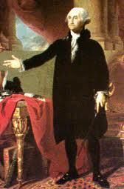
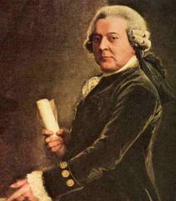
Presidential Selection
The Original Electoral College
Each elector had 2 votes, which were cast separately
1st place = President
2nd place = Vice President
Problems ?

Slide 41
What happens if a Majority Isn’t Reach??
If no candidate gets a majority (270 electoral votes), then the House of Representatives will select the President.
Each state has one vote
Ballots will continue to be cast until one candidate receives a majority

Slide 42
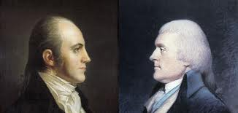
Early Problems With The Electoral College
The Election of 1800
Democratic-Republicans tried to “fix” the election
There was a tie between Thomas Jefferson and Aaron Burr
This leads to the creation of the 12th Amendment
Notes:
http://www.archives.gov/legislative/features/1800-election/1800-election.html
35 rounds of ballots before Jefferson was determined to be President and Burr Vice President. The 4 years following were not very pleasant for the President and Vice President.

Slide 43
12th Amendment
Redefines how the President and Vice-President are chosen by the Electoral College, making the two positions cooperative, rather than first and second highest vote-getters.
It also ensures that anyone who becomes Vice-President must be eligible to become President.

Slide 44
Presidential Succession
We use a system called “winner take all” that means that if the popular vote is won in the state, all the “electoral votes” will go to that candidate.
This is true of every state but Nebraska, which uses proportional representation, splits their electors between the candidates based on the popular vote.
Notes:
www.uselectionatlas.org/

Slide 45
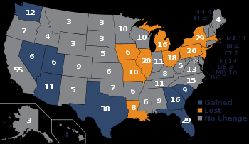
Michigan & the Electoral College
Michigan will have 16 electoral votes in the 2012 election
Therefore, each political party will select their own 16 electors from the State.
If the candidate wins Michigan, their electors will cast ballots for the electoral college.

Slide 46
Criticisms of the Electoral College
Criticisms of the Electoral College:
Division of votes is unfair
One can win popular votes, yet still lose the electoral vote and therefore not become President.
2000 Presidential Election
Ideas for Reform: Eliminate the Electoral College and base the vote on only the popular vote

