Slide 1
The Mole
6.02 X 10²³

Slide 2
The Mole
A counting unit
Similar to a dozen, except instead of 12, it’s 602 billion trillion 602,000,000,000,000,000,000,000
6.02 X 10²³ (in scientific notation)

Slide 3
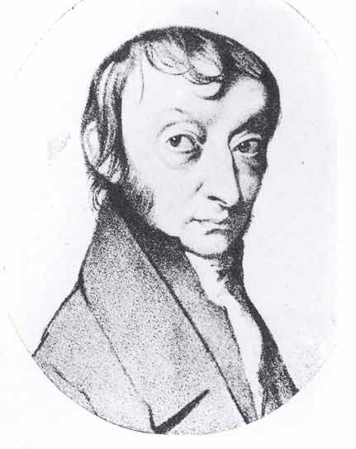
This number is named in honor of Amedeo Avogadro (1776 – 1856), who studied quantities of gases and discovered that no matter what the gas was, there were the same number of molecules present

Slide 4
Just How Big is a Mole?
Enough soft drink cans to cover the surface of the earth to a depth of over 200 miles.

Slide 5
Just How Big is a Mole?
If you had Avogadro's number of unpopped popcorn kernels, and spread them across the United States of America, the country would be covered in popcorn to a depth of over 9 miles.
If we were able to count atoms at the rate of 10 million per second, it would take about 2 billion years to count the atoms in one mole.

Slide 6
Everybody Has Avogadro’s Number! But Where Did it Come From?
It was NOT just picked! It was MEASURED.
One of the better methods of measuring this number was the Millikan Oil Drop Experiment
Since then we have found even better ways of measuring using x-ray technology

Slide 7
The Mole
1 dozen cookies = 12 cookies
1 mole of cookies = 6.02 X 10²³ cookies
1 dozen cars = 12 cars
1 mole of cars = 6.02 X 10²³ cars
1 dozen Al atoms = 12 Al atoms
1 mole of Al atoms = 6.02 X 10²³ atoms
Note that the NUMBER is always the same, but the MASS is very different!

Slide 8
A Mole of Particles Contains 6.02 x 10²³ particles
= 6.02 x 10²³ C atoms
= 6.02 x 10²³ H₂O molecules
= 6.02 x 10²³ NaCl “molecules”
1 mole C
1 mole H₂O
1 mole NaCl

