Slide 1
Types of Law

Slide 2
Civil Law
The law that governs the relations between individuals and defines their legal rights.
Most cases in federal court involve civil law
Usually the plaintiff seeks damages in the from of money from the defendant.

Slide 3
Criminal Law
Law that defines crimes against the public order and provides for punishment
Most cases are settled in the state courts
The government is always the prosecution and brings charges against the individual.

Slide 4
Examples of federal charges are kidnapping, tax fraud, selling narcotics, driving a stolen vehicle across state lines.
If found guilty a person may pay a fine, go to prison or even receive the death penalty.

Slide 5
Constitutional Law
The court decisions whether or not a law or action conflicts with the Constitution
Most of these cases decide the limits of the government’s power and the rights of the individual.

Slide 6
The Judicial Branch

Slide 7
The Beginnings
Article III of the U.S Constitution creates the Supreme Court and the Judicial Branch of the government.
Article III summary: The Supreme Court decides court cases according to US Constitution. The courts under the Supreme Court decide criminal and civil court cases according to the correct federal, state, and local laws.
Article I gives Congress the power to create legislative courts.
The Judiciary Act of 1789 created Federal District Courts.
1891: Congress creates Federal Appeals Courts

Slide 8
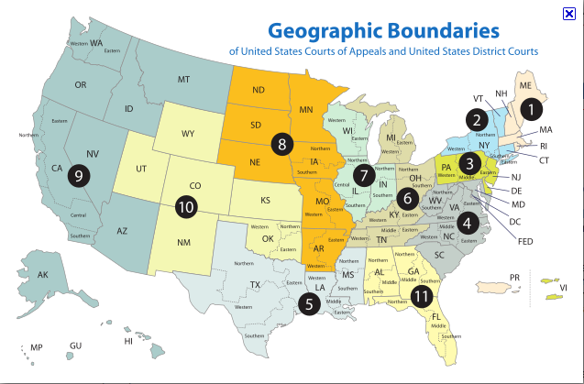
The Federal Court System in the United States

Slide 9
The Federal Court System in the United States
Located in the following cities (in order):
Boston
New York
Philadelphia
Richmond
New Orleans
Cincinnati
Chicago
St. Louis
San Francisco
Denver
Atlanta
Washington, D.C.

Slide 10
Jurisdiction
Jurisdiction means to have the authority to hear a case.
Original Jurisdiction: Authority to hear the case first. (Ex. A circuit court would need to hear a case first before ANY Supreme Court were to hear it.)
Appellate Jurisdiction: Can hear a case on appeal from a lower court. Must go through the court system first before reaching the appeal stage.
Exclusive Jurisdiction: Only a Federal Court can hear and decide on the case. (Ex. Kwame Kilpatrick’s case as it deal with issues of money laundering, which is a Federal crime.)
Concurrent Jurisdiction: Both State and Federal governments share the authority. (Ex.

Slide 11
Jurisdiction
State Jurisdiction: Has the authority over state laws. This is considered a state right.
Federal Jurisdiction: The following are exclusive to Federal courts:
Interpretation/application of the Constitution and Federal law
Treaty
Maritime Law
Cases involving the Federal government, ambassadors, ministers, consuls
Disputes between states
Issues involving foreign citizens bringing suit against a state or a U.S. citizen
Patents
Copyrights
Bankruptcy
Federal crimes

Slide 12
Lower Federal Courts
District Courts
Where trials begin at the Federal level
Has original jurisdiction
Each has jurisdiction over a geographic area (94 Total)
District Court Judges
At least 2 per state
Responsibility to decide legal procedures and explain them to juries
Determine punishment or fines
Appointed for life by the President and confirmed by the Senate
Other court officials
Magistrate: issues court orders and determines whether a case should be brought to trial
U.S. Attorney: The government’s lawyer
Marshal: makes arrests, serves subpoenas, delivers defendants to court
Misc. Bailiff, stenographer and clerk

Slide 13
Lower Federal Courts
U.S. Court of Appeals
Has appellate jurisdiction
12 appellate courts have jurisdiction over a circuit or specific geographic area
Appellate Court Judges
Appointed by the President for life, confirmed by the Senate
Panel hears arguments and reviews records from lower courts.
Types of rulings:
Uphold lower court ruling
Overturn lower court ruling
Remand (return) the case to lower court for a new trial

Slide 14
Lower Federal Courts
Special Federal Courts
U.S. Tax Court: hears civil cases involving disputes over the application of tax laws.
U.S. Claims Court: hears claims from all over the U.S. against the federal government.
Military Appeals: hears appeals from court-martial convictions (court of last resort for the military); new jurisdiction over those accused of terrorist crime.
International Trade: deals with civil cases arising out of tariff and trade-related law.

Slide 15
Juries
Grand Jury
A jury selected to examine the validity of an accusation before trial.
Petit Jury
A jury of 12 to determine the facts and decide the issue in civil or criminal proceedings.

Slide 16
The Supreme Court
Judicial Review
Definition: the power to decide on the constitutionality of an act of government
Established in Marbury v. Madison (1803)
Ultimate authority on interpreting the Constitution
Arbiter of disputes between states and between states and federal government
Facts of the Supreme Court
Has both original and appellate jurisdiction, but most cases come from appeals court
Their decision cannot be overturned (unless by constitutional amendment)
Has complete control over its own caseload
Hears cases involving a significant legal or constitutional principle or questions of public interest
Receives over 5,000 case request per year; usually selects between 100-200 cases

Slide 17
The Supreme Court
Supreme Court Justices
Current composition is 1 Chief Justice and 8 Associate Justices
Number of justices is determined by Congress
Appointed by the President and confirmed by the Senate
First Chief Justice: John Jay
First African-American Justice: Thurgood Marshall
First Female Justice: Sandra Day O’Conner
First President to serve after finishing his term as President: William H. Taft

Slide 18
The Supreme Court
The Supreme Court at Work
Conducts its business from October until June or July
Most cases come on appeal by a request of a writ of certiorari (formal request to bring a case before the Supreme Court)
How justices decide which cases to select
Rule of Four: 4 justices must vote to accept the case
The case is then placed on the court docket, or calendar
When the court is sitting (in session), the justices usually hear arguments for 30 minutes per side-although they may make changes to this procedure on occasion (Ex. Bush v. Gore).
Decisions and Opinions
Justices meet privately on Wednesday’s and Friday’s to discuss cases.
Opinions are received by the Chief Justice from Associate Justices in order of Seniority
A vote is taken; a simple majority determines the outcome
In the event of a tie, the lower court’s decision is upheld
The writing of opinions is assigned
Majority Opinion (reasons for the majority’s vote)
Concurring Opinion (those who agree with the majority decision, but for different reasons)
Dissenting Opinion (reasons for opposing the decision)

Slide 19
The Supreme Court
Supreme Court Chain of Events
1. Vote to hear the case (4)
2. Brief, overview of argument
3. Docket, Schedule the case
4. Cases presented
5. Conferences
6. Decision—Opinions—Majority, concurring, dissenting
Judicial Philosophy
*Stare Decisis: Precedent, ruling is a model for future cases.
*Judicial Restraint: Court should not contradict other elected officials (Ex. President and Congress).
*Judicial Activism: Active role in making policy through courts decisions.

Slide 20
The Supreme Court
OYEZ Video
Notes:
http://www.oyez.org/media/scotus_video1

Slide 21
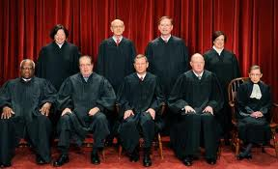
The Supreme Court Justices
Chief Justice John G. Roberts
Justice Antonin Scalia
Justice Anthony M. Kennedy
Justice Clarence Thomas
Justice Ruth Bader Ginsburg
Justice Steven G. Breyer
Justice Samuel Anthony Alito, Jr.
Justice Sonia Sotomayor
Justice Elena Kagan

Slide 22
Major Supreme Court Cases
Marbury v. Madison (1803)- Established the judicial branch.
Brown v. Board of Education of Topeka Kansas (1954)- determined that separate but equal was unconstitutional.
Tinker v. DeMoines (1969)-Student speech; free speech (armbands)
Miranda v. Arizona (1966)-Self incrimination and the Fifth Amendment. (Miranda Rights)
Roe v. Wade (1973)-Unconstitutional to not allow an abortion in the first trimester.
Regents of the University of California v. Bakke (1978)-Having racial quotas in college admissions is unconstitutional; affirmative action

