Slide 1
Newton’s First Law of Motion - Inertia
Chapter 2

Slide 2
Famous physicists views on motion

Slide 3
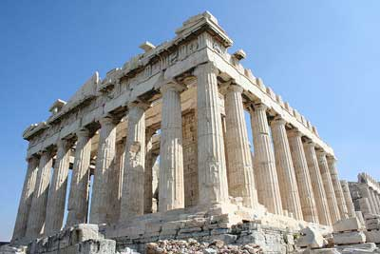
The idea that a force causes motion goes back to the 4th Century B.C. and the Ancient Greeks.

Slide 4
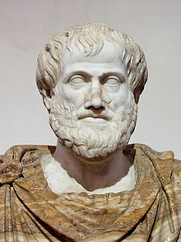
Aristotle
Motion
Divided motion into two main classes:
Natural motion
Violent motion

Slide 5
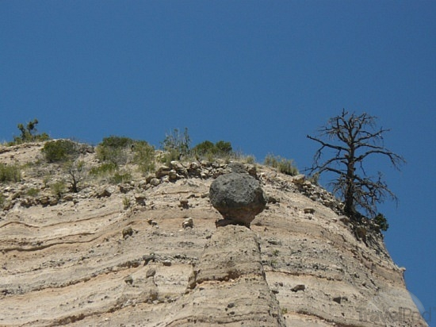
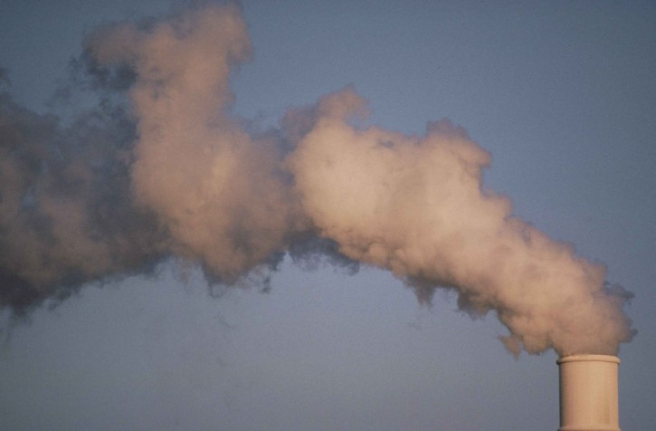
Natural Motion
He felt that every object in the universe had a proper place determined by its “nature”
Any object not in its proper place will strive to return to its proper place
Natural Motion on Earth was thought to be either straight up or straight down

Slide 6
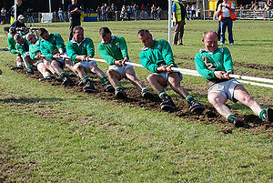
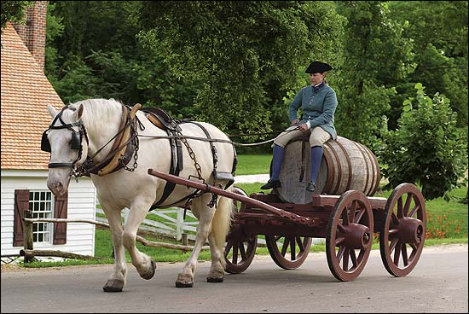
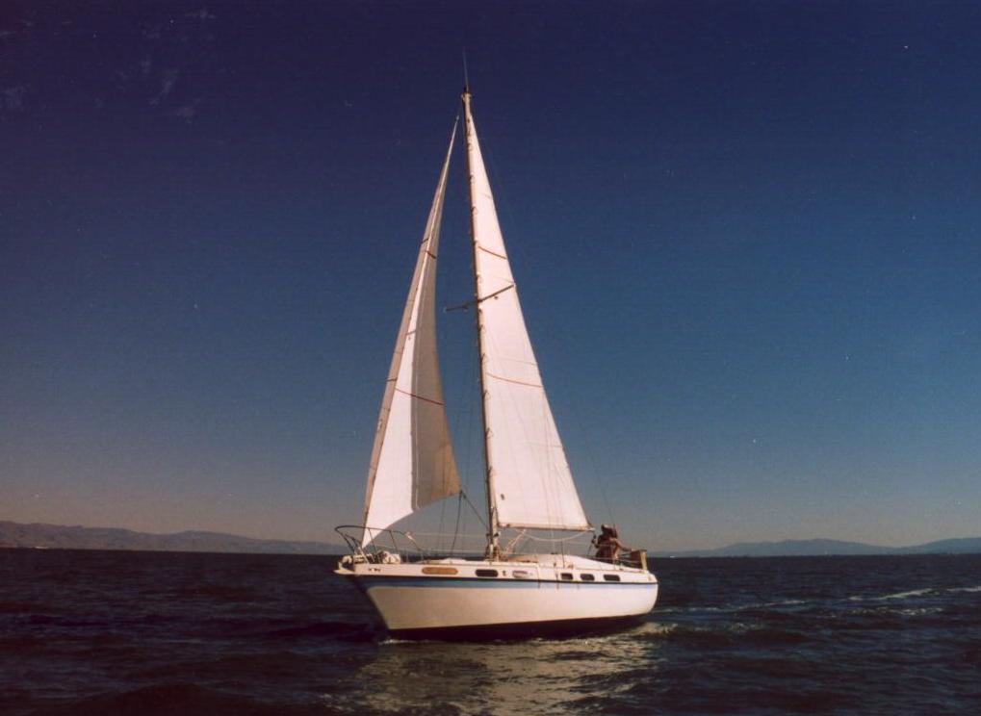
Violent Motion
Resulted from pushing or pulling forces
Violent motion had to be imposed by something

Slide 7
The normal state of objects is at rest
With the exception of celestial objects
Aristotle taught that all motions are due to a sustained push or pull.
Provided that an object is in its proper place, it will not move unless subjected to a force.

Slide 8
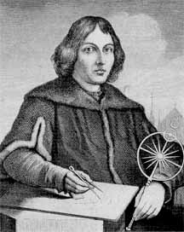
Copernicus
Polish astronomer
Believed that the sun was at the center of the universe, not the earth as previously taught.
He discovered this through observation
He published his findings on his death bed, because he feared persecution.

Slide 9
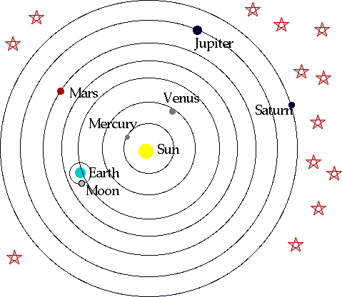
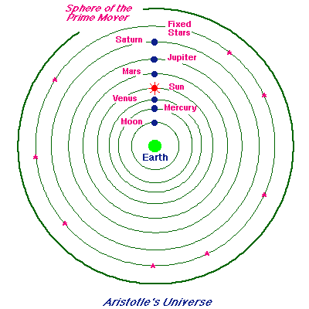
Geocentric Model vs. Heliocentric Model
Earth at the Center
Sun at the Center

Slide 10
Galileo
He was the first to provide conclusive proof through observation and experiment, that the sun was at the center of the universe not earth.

Slide 11
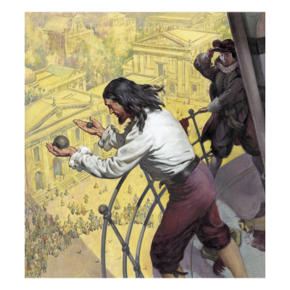
The Leaning Tower of Pisa
He found that objects of various weights, when released at the same time, fell together and hit the ground at the same time.

Slide 12
Galileo’s Inclined Planes
Aristotle thought that an object required a push or a pull to keep it moving.
Galileo felt that an object will keep moving in a straight line forever; no push, pull, or force of any kind is necessary.

Slide 13
Galileo’s Inclined Planes Cont.
He tested his hypothesis
He noted that balls rolling down a hill picked up speed and ball rolling up a hill lost speed.
From this he reasoned that balls rolling along a horizontal plane would neither speed up or slow down. The ball would finally come to a rest not because of its “nature” but because of friction.

Slide 14
Galileo’s Inclined Planes Cont.
When there was less friction, the motion of objects persisted for a longer time and the motion had a constant speed.
Galileo thought that in the absence of friction or other opposing forces, a horizontally moving object would continue moving indefinitely.
http://www.youtube.com/watch?v=ZUgYc6Bi46w
http://www.youtube.com/watch?v=yc-FPEnp8Gg&feature=related

Slide 15
Inertia
The property of things to resist changes in motion.
Galileo’s concept of inertia would show that no force is required to keep the Earth moving forward.

Slide 16
Mechanical Equilibrium

Slide 17
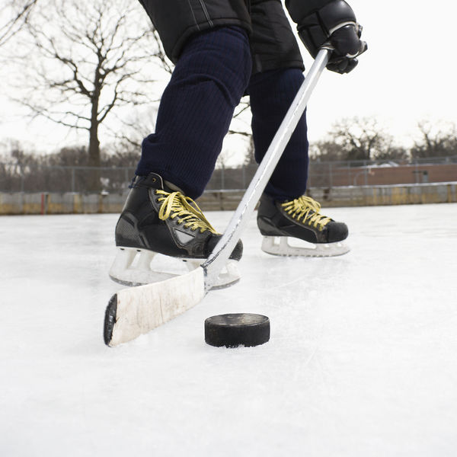
Force
Force is a push or a pull
It can be gravitational, electrical, magnetic or a muscular effort
Force of some kind is always required to change the state of motion of an object.

Slide 18
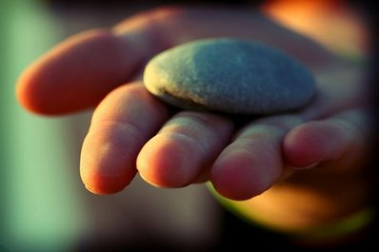
Net Force
Most often, there is more than one force acts on an object.
When more than a single force acts on an object, it is considered a net force
The vector sum of forces that act on an object

Slide 19
You are pushing upward on the rock with as much force as the Earth’s gravity pulls down on it.
If you push harder it will move upward, if you push less it will move downward
Holding the rock at rest means that the upward and downward forces on the rock equal zero. Therefore the net force acting on the rock is zero

Slide 20
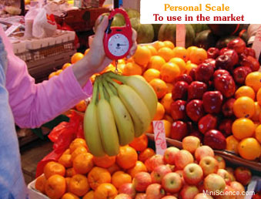
Tension and Weight
The stretched spring is under a “stretching force” called tension.
There are two forces acting on the bananas
Tension providing a upward force
Weight providing a downward force

Slide 21
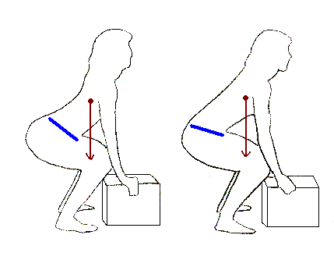
Vector
A vector is an arrow that represents the magnitude and direction of a quantity.

Slide 22
Vector and Scalar Quantities
Vector Quantity
A quantity such as force that has both magnitude and direction is called a vector quantity.
Force is an example of a vector quantity
Scalar Quantity
A quantity that can be described by magnitude only and has no direction
Time, area, and volume are examples of scalar quantity

Slide 23
Mechanical Equilibrium
A state wherein no physical changes occur.
Whenever the net force on a object is zero, the object is said to be in mechanical equilibrium.
This is known as the Equilibrium Rule

Slide 24
The Equilibrium Rule
For any object or system of objects in equilibrium, the sum of the forces acting equals zero.
In equation form, ΣF = 0
Σ – stands for “the sum of”
F – stands for “forces”
The rule states that the forces acting upward on the object must be balanced by other forces acting downward to make the vector sum equal zero.

Slide 25
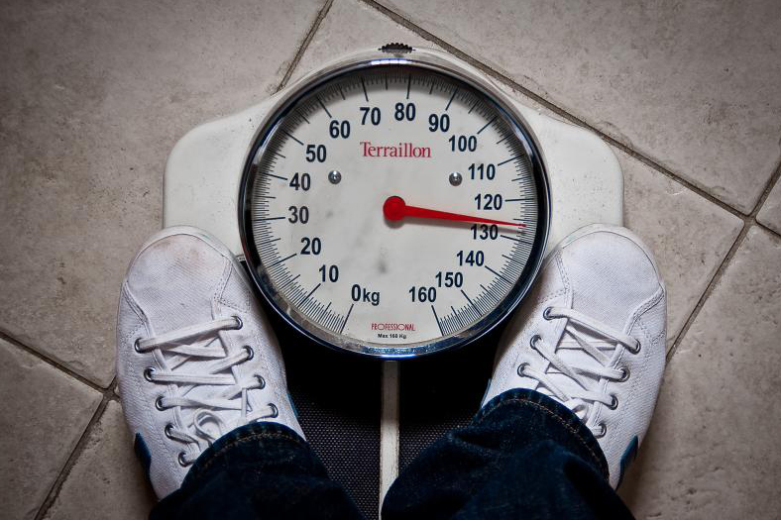
Support Force
The upward force that balances the weight of an object on a surface.
Notes:
What forces are acting on your book/notebook resting on your desk? Where is the upward force coming from? (it’s called support force)

Slide 26
Equilibrium of Moving Objects
Equilibrium is a state of no change
When an object isn’t moving it is in equilibrium
An object moving at constant speed in a straight line is also in a state of equilibrium
ΣF = 0

Slide 27
Newton’s First Law of Motion
Inertia…

Slide 28
What is Inertia?
Inertia is the property of a body to resist change to its state of motion.

Slide 29
Newton’s First Law of Motion
Every object continues in its state of rest, or of uniform motion in a straight line, unless acted on by a nonzero net force.
Aka the Law of Inertia
Objects at rest tend to stay at rest; objects in motion tend to stay in motion.
Notes:
A restatement of Galileo’s idea that a force is not needed to keep an object moving.

Slide 30
Things tend to keep on doing what they are already doing.
The ancients thought that continual forces were needed in order to keep an object moving, but we now know that in fact they will continue to move by themselves.

Slide 31
On The White Boards…
Explain what’s going to happen? What forces are acting on it?
Pulling a table cloth out under dishes…
Jamie hits a hockey puck on the ice then proceeds to hit that same hockey puck on the street…
Notes:
http://www.youtube.com/watch?v=nSj_MVUsBzg
Friction…

Slide 32
Which will move farther? And why?
An empty can
A can filled with sand
A can filled with nails

Slide 33
The amount of inertia an object has depends on its mass.
The more mass an object has, the greater its inertia and the more force it takes to change its state of motion

Slide 34
What is Mass?
Mass is not a volume
Volume is a measure of space
An object can have a large mass, but take up very little space
Mass is not a weight
Mass is a measure of the amount of material in an object and depends only on the number of and kind of atoms that compose it
Weight is a measure of gravitational force acting on the object
Mass is inertia…

Slide 35
The amount of material in a particular stone is the same whether the stone is located on Earth, the Moon or in Space, therefore the mass of the stone is the same in all of these locations.

Slide 36
Mass
The quantity of matter in an object
Mass is a measure of inertia, that an object exhibits in response to any effort to start it, stop it, or otherwise change its motion

Slide 37
Weight
Weight is the force of gravity on an object
Weight and mass are not the same thing, they are however proportional to each other in a given place
Objects with great mass, have great weight
Objects with little mass, have little weight

Slide 38
Newton
A Newton is the SI Unit for Force
Symbol = N
pound force (lbf) = 0.225 = 1 Newton
1 kg = 10 Newton’s
If you know the weight in kg, then all you need to do is multiply by 10 in order to get the weight in Newtons.

Slide 39
Why does the Earth move?
Why don’t we feel the Earth moving? Everything appears still, so how can it be moving???

Slide 40
Objects move with the Earth
The Earth moves at a rate of 30km/s
Everything on Earth also moves at this rate
The Law of Inertia states that objects in motion remain in motion if no unbalanced forces act on them.

