Slide 1
Sound
Chapter 20

Slide 2
If a tree fell in the middle of a deep forest hundreds of kilometers away from any living being, would there be a sound?
Use your knowledge of waves & physics to answer the question.

Slide 3
Sound
Longitudinal wave phenomenon that consists of successive compressions and rarefactions of the medium through which the wave travels.

Slide 4
Origin of Sound
Most sounds are waves produced by the vibrations of material objects.
A guitar, the sound is produced by the vibrating strings
A clarinet, the sound is produced by a vibrating reed
A flute, the sound is produced by a fluttering column of air at the mouthpiece.
Your voice results from the vibration of your local chords.

Slide 5
The original vibration stimulates the vibrations of something larger or more massive, such as the sounding board of a stringed instrument, the air column within a reed or wind instrument.
The vibrating material then sends a disturbance through the surrounding medium, usually air, in the form of longitudinal waves.

Slide 6
Under ordinary conditions, the frequency of the vibrating source and the frequency of the sound waves produced are the same.
We describe our subjective impression about frequency of sound by the word pitch.
Frequency corresponds to pitch

Slide 7
Sound waves with frequencies below 20 hertz are infrasonic
Sound waves with frequencies above 20,000 hertz are called ultrasonic
We cannot hear infrasonic and ultrasonic sound waves

Slide 8
Nature of Sound in Air

Slide 9
When we clap our hands, the sound produced is nonperiodic.
It consists of a wave pulse that travels out in all directions.
The pulse disturbs the air in the same way that a similar pulse would disturb a coiled spring or a Slinky.
Each particle moves to and fro along, the direction of the expanding wave.

Slide 10
Compression
Condensed region of the medium through which a longitudinal wave travels.

Slide 11
Rarefaction
Rarefied region (of reduced pressure) of the medium through which a longitudinal wave travels.

Slide 12
Example…
Think about the radio loudspeaker and a paper cone sitting next to the radio. What happens to the paper cone as music plays in the loudspeaker?
You find that the paper cone vibrates in rhythm with an electrical signal. Air molecules next to the vibrating cone of the speaker are themselves set into vibration, which in turn vibrates against neighboring particles, and so on.
The resulting vibrating air sets your eardrum into vibration, which in turn sends cascades of rhythmic electrical impulses along the cochlea nerve canal and into the brain. An you listen to the sound of music

Slide 13
Media That Transmit Sound

Slide 14
Most sounds that we hear are transmitted through the air.
However, any elastic substance – whether solid, liquid, gas, or plasma – can transmit sound.
Recall that elasticity is the ability of a material that has changed shape in response to an applied force to resume its initial shape once the distorting force is removed.

Slide 15
Sound Travels…
Four times faster in water than in air and about 15 times faster in steel then air.
Relative to solids and liquids, air is a poor conductor of sound.

Slide 16
Liquids and crystalline solids are generally excellent conductors of sound.
The speed of sound is generally greater in solids than in liquids and greater in liquids then in gases.

Slide 17
Sound won’t travel in vacuum because the transmission of sound requires a medium.
If there is nothing to compress and expand, there can be no sound.

Slide 18
Speed of Sound in Air

Slide 19
The speed of sound depends on wind conditions, temperature, and humidity.
It doesn’t depend on the loudness or the frequency of the sound
All sound travels at the same speed

Slide 20
Reflection of Sound

Slide 21
We call the reflection of sound an echo
The fraction of energy carried by the reflected sound wave is large if the surface is rigid and smooth and less if the surface is soft and irregular.
Sound energy not carried by the reflected sound wave is carried by the “transmitted” (absorbed) wave.

Slide 22
Both sound and light obey the same law of reflection
Therefore, sound reflects from a smooth surface the same way that light does.
The angle of incidence is equal to the angle of reflection

Slide 23
Sometimes when sound reflects from the walls, ceiling, and floor of a room the sound can become garbled.
This is due to multiple reflections called reverberations

Slide 24
However, if the reflective surfaces are too absorbent, the sound level will be too low and the hall will sound dull and lifeless.
Reflection of sound in a room makes it sound lively and full, which is why many people choose to sing in the shower.

Slide 25
Acoustics
The study of sound properties
Music halls often place highly reflective surfaces behind the stage to direct sound or reflective surfaces are suspended above the stage in some concert halls.

Slide 26
Refraction of Sound

Slide 27
Sound waves bend when parts of the wave fronts travel at different speeds
This bending of sound is called refraction

Slide 28
On a warm day, the air near the ground may be appreciably warmer than the rest of the air so the speed of sound near the ground increases.
Sound waves therefore tend to bend away from the ground, resulting in sound that does not seem to travel well

Slide 29
Under Water
Refraction of sound occurs underwater
The speed of sound varies with temperature
This poses of problem for surface vessels that wish to chart the bottom of the sea, but it is a blessing for submarines who wish to escape detection

Slide 30
This technique of using multiple reflections and refractions of ultrasonic waves is used in ultra sounds

Slide 31
Energy in Sound Waves

Slide 32
Wave motion of all kinds possesses energy off varying degrees.
Electromagnetic wave bring us the enormous amounts of energy (which make life possible), by comparison the energy in sound is extremely small

Slide 33
Sound energy dissipates to thermal energy while sound travels in air.
For waves of higher frequency, the sound energy is transformed into internal energy more rapidly than for waves of lower frequencies.
As a result, sound of low frequencies will travel faster through air than sound of higher frequencies
Which is why the foghorns of ships are of a low frequency

Slide 34
Forced Vibrations

Slide 35
If you were to strike a tuning fork, the sound from it may be rather faint. However, if you hold the same tuning fork close to the table, the sound is louder.
The table is being forced to vibrate. This is referred to as forced vibration
This idea is used in musical instruments and music boxes. Both use a sounding board, without the sounding board the sound produced is barely audible.

Slide 36
Natural Frequency

Slide 37
Two objects vibrate differently when they are struck.
Any object composed of an elastic material when disturbed will vibrate at its own special set of frequencies, which together form its special sound
This is known as the object’s natural frequency

Slide 38
Resonance

Slide 39
Resonance
When the frequency of forced vibrations on an object matches the object’s natural frequency, a dramatic increase in amplitude occurs.
Resonance means “resounding” or “sounding again”
In order for something to resonate it needs a force to pull it back to its starting position and enough energy to keep it vibrating.
Resonance is not restricted to wave motion. It occurs whenever successive impulses are applied to a vibrating object in rhythm with its natural frequency.

Slide 40
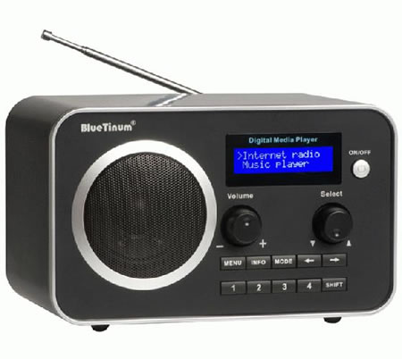
Examples of Resonance

Slide 41
On 12 April 1831, the 60th Rifle Corps carried out an exercise on Kersal Moor under the command of Lieutenant P. S. Fitzgerald, the son of John Fitzgerald.
As a detachment of 74 men returned to barracks in Salford by way of the bridge the soldiers, who were marching four abreast, felt it begin to vibrate in time with their footsteps. Finding the vibration a pleasant sensation some of them started to whistle a marching tune, and they began to "humour it by the manner in which they stepped", causing the bridge to vibrate even more.
The head of the column had almost reached the Pendleton side when they heard "a sound resembling an irregular discharge of firearms".
Immediately, one of the iron columns supporting the suspension chains on the Broughton side of the river fell towards the bridge, carrying with it a large stone from the pier to which it had been bolted.
The corner of the bridge, no longer supported, then fell 16 or 18 feet into the river, throwing about 40 of the soldiers into the water or against the chains.
As the water was only about two feet (60 cm) deep at that point none of the men were killed, but 20 were injured, including six who suffered severe injuries including broken arms and legs, severe bruising, and contusions to the head.

Slide 42
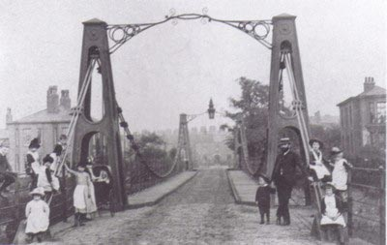
Broughton Suspension Bridge
The bridge was later rebuilt.

Slide 43
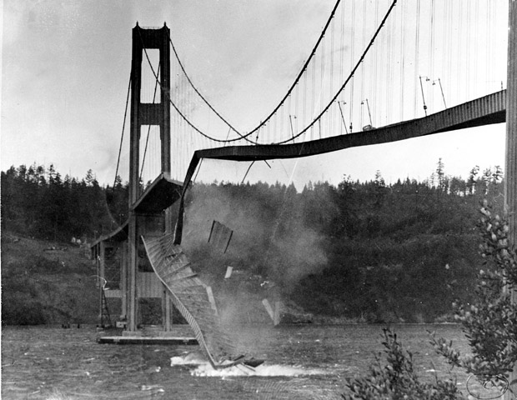
Tacoma Narrows Bridge (1940)
In 1940, four months after being completed.
This bridge was destroyed by wind-generated resonance.
A mild gale produced an irregular force in resonance with the natural frequency of the bridge, steadily increasing the amplitude of vibration until the bridge collapsed.

Slide 44
Interference

Slide 45
Sound waves can be made to exhibit interference
In the case of sound, the crest of a wave corresponds to a compression and the through of a wave corresponds to a rarefaction.
Interference occurs for all waves, both transverse and longitudinal.
Look at figure 20.16 on p.390

Slide 46
Beats

Slide 47
When two tones of slightly different frequency are sounded together a fluctuation in the loudness of the combined sounds is heard; the sound if loud, then faint, then loud, then faint and so on.
This periodic vibration in the loudness of sound is called beats and is due to interference.
Beats can occur with any kind of wave

