Slide 1
Electrons In Atoms
Chapter 5

Slide 2
Light & Quantized Energy
Section1

Slide 3
In the early 1900’s scientists to unravel the puzzle of chemical behavior.
They observed elements when heated in a flame & they discovered that an elements chemical behavior is related to the arrangement of its atoms.

Slide 4
Light Travels As A Wave
A particular wave is characterized by 3 properties: wavelength, frequency, & speed
The wavelength (λ) is the distance between 2 consecutive wave peaks
Frequency (ν) indicates how many eave peaks pass a certain point per a given time period

Slide 5
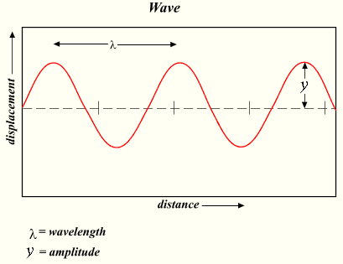

Slide 6
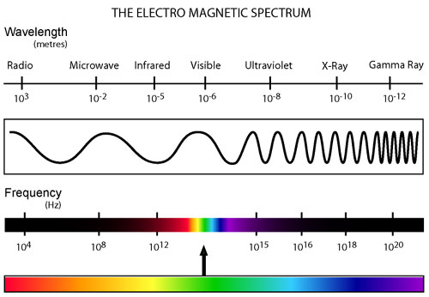
Electromagnetic Spectrum

Slide 7
Another way to think of a beam of light traveling through space, is as a stream of time packets of energy called photons.

Slide 8
Different wavelengths of electromagnetic radiation carry different amounts of energy
In general the longer wavelength of light, the lower the energy of its photons

Slide 9
Emission of Energy by Atoms
http://www.youtube.com/watch?v=jJvS4uc4TbU

Slide 10
The colors of these flames result from atoms in theses solutions releasing energy by emitting visible light of specific wavelengths (that is specific colors)

Slide 11
The heat from the flame causes the atoms to absorb energy
When this happen we say that the atoms are moved to an excited state
An atom cannot stay in the excited state forever though, when the atom drops back down to a lower state some of the excess energy is then released in the form of light.
It emits a photon of light

Slide 12
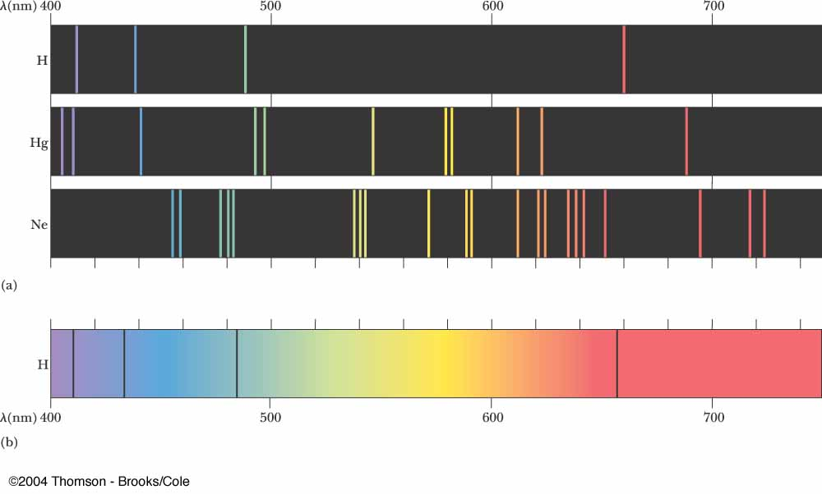
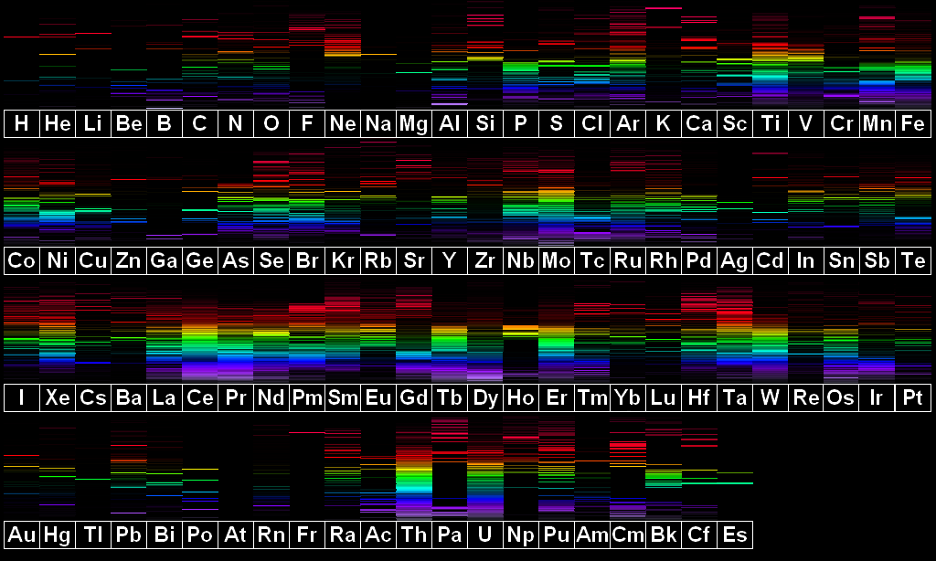
Atomic Emission Spectra

Slide 13
Quantum Theory & the Atom
Section 2

Slide 14
Bohr’s Model of the Atom
In 1911 at the age of 25 Niels Bohr received his Ph.D. in physics.
Bohr proposed that the H atom has only certain allowable energy states.
He constructed a model of the hydrogen atom with quantized energy levels.

Slide 15
Ground State – The lowest allowable energy state of an atom.
Quantum Number - n
Indicates the relative size and energy of atomic orbitals.

Slide 16
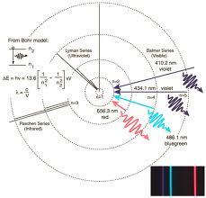
He pictured the electron moving in circular orbits corresponding to the various allowed energy levels.
Bohr suggested that the electron could jump to a different orbital by absorbing or emitting a photon of light with exactly the correct energy content.

Slide 17
However, when this model was applied to atoms other than hydrogen, it did not work.
Electrons do not move around the nucleus in circular orbits like planets orbiting the Sun

Slide 18
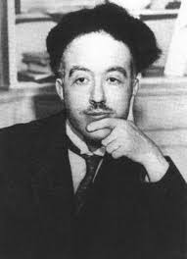
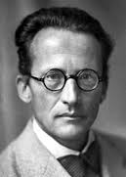
Louis Victor de Broglie & Erwin Schrodinger suggested that because light seems to have both wave and particle characteristics, the electron might also exhibit these characteristics.

Slide 19
This model has orbitals. Orbitals are nothing like orbits
According to the wave mechanical model, the electrons location is not always known. We simply have an area where the likelihood of finding an electron is increased.

Slide 20
Orbital
The three-dimensional region in which there is a high probability of finding an electron in an atom.

Slide 21
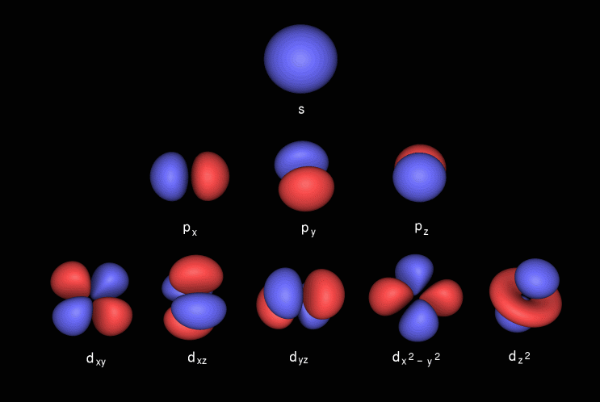

Slide 22
As n (principle quantum number) increases, the orbital becomes larger.
The electron spends more time away from the nucleus and the atom’s energy increases.

Slide 23
Therefore, n specifies the atom’s major energy level.
Each major energy level is called a principal energy level
n values range from 1 to 8
1 being the lowest principal energy level
8 being the light principal energy level that we have detected so far

Slide 24
Principal energy levels contain energy sublevels.
Principal 1 consists of a single sublevel
Principal 2 consists of two sublevels
Principal 3 consists of three sublevels
And so on…
Notes:
Show animation here.

Slide 25
These sublevels are labeled
s, p, d, or f

Slide 26
Electron Configuration
Section 3

Slide 27
Electron Configuration
The arrangement of electrons in an atom is called the atom’s electron configuration.
With electron configurations we assume that the arrangement gives the atom the lowest possible energy
This is because low-energy systems are more stable than high-energy systems

Slide 28
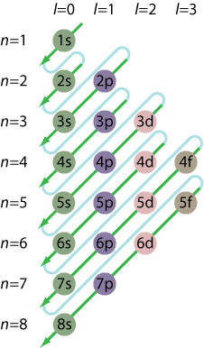
Aufbau Principle
Each electron occupies the lowest energy orbital available.

Slide 29
The s orbital can hold 2 electrons
The p orbital can hold 6 electrons
The d orbital can hold 10 electrons
The f orbital can hold 14 electrons

Slide 30
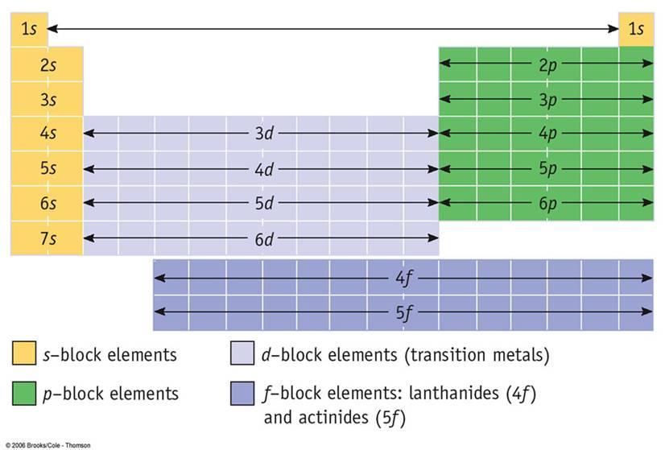

Slide 31
Electron Configuration Notation
Na
Mg
Al
Si
P
S
Cl
Ar

Slide 32
Pauli’s Exclusion Principle
States that a maximum of two electrons can occupy a single atom orbital, but only if the electrons have opposite spins.

Slide 33
Hund’s Rule
States that single electrons with the same spin must occupy each equal-energy orbital before additional electrons with opposite spins can occupy the same orbitals.
Recall that negatively charged electrons repel each other.

Slide 34
Example Orbital Diagram

Slide 35
Orbital Diagram
H
He
Li
B
C
N
O
F
Ne

Slide 36
Nobel Gas Notation
Shorthand electron configurations
Use the Nobel Gas that comes before that particular element.
Then you put that Nobel Gas in brackets.
The continue with the electron configuration until you reach a particular element
Example: Sr
Notes:
See table 5 on p.159

Slide 37
Nobel Gas Notation
Mg
Al
Si
P
S
Cl
Ar

Slide 38
Exceptions to Predicted Configurations
You can use the Aufbau diagram to write the correct ground state electron configuration for all elements up to and including Vanadium (V 23).
After this point things change a little. Elements will half-fill and fill sets of s and d orbitals in order to gain increased stability.
See Electron Configuration Table

Slide 39
Valance Electrons
Electrons in the atom’s outermost orbitals – generally those associated with the atom’s highest principle energy level.
These electrons help to determine the chemical property of an element and are involved in bonding.

Slide 40
Electron Dot Structure
Because valence electrons are involved in forming chemical bonds, chemists often represent them visually using an electron dot structure.
Electron dot structures consist of the elements symbol, which represents the atomic nucleus & inner electrons, surrounded by dots representing all of the atoms valence electrons.

Slide 41
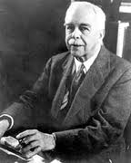
G.N. Lewis devised this method in 1902 while teaching a college chemistry class.
Electron Dot Configurations are known as Lewis Dot Structures

Slide 42
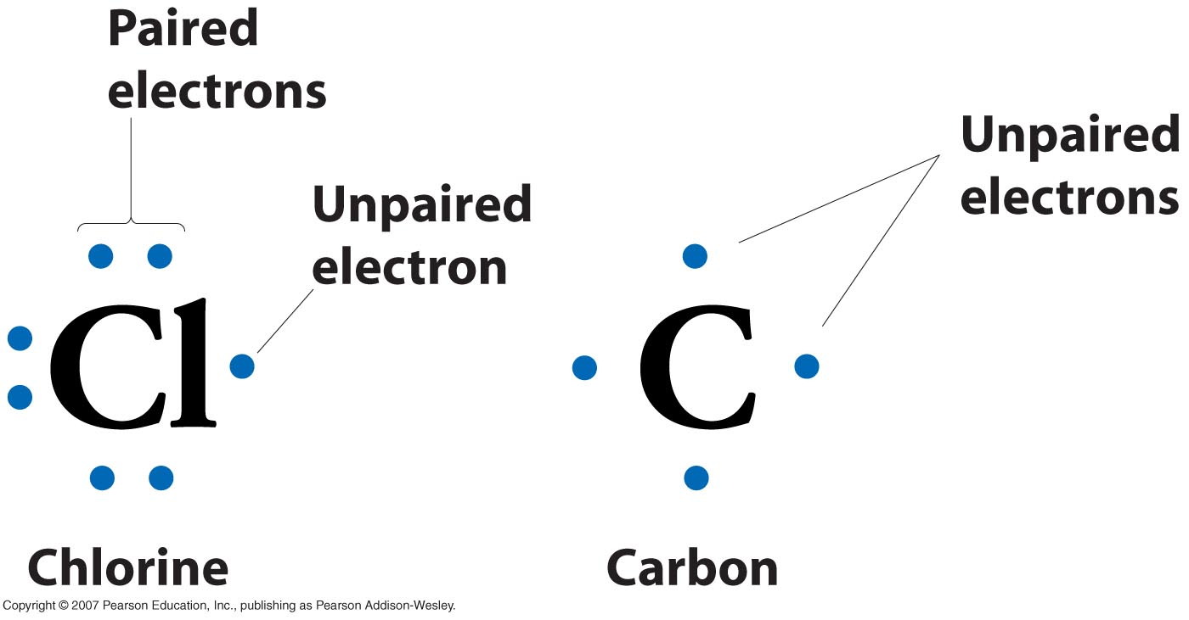

Slide 43
