Slide 1
Mixtures of Matter
Section 3

Slide 2
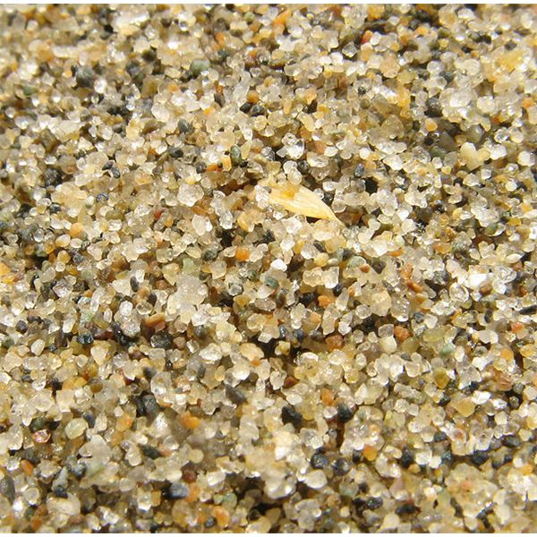
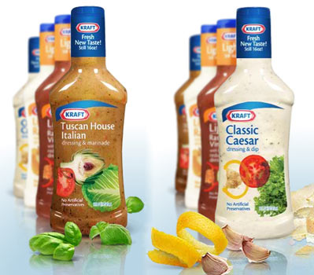
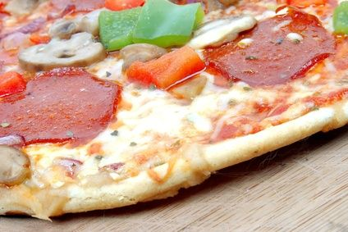
Mixtures
A mixture is a combination of two or more pure substances in which each pure substance retains its individual chemical properties.
Most everyday substances are mixtures.

Slide 3
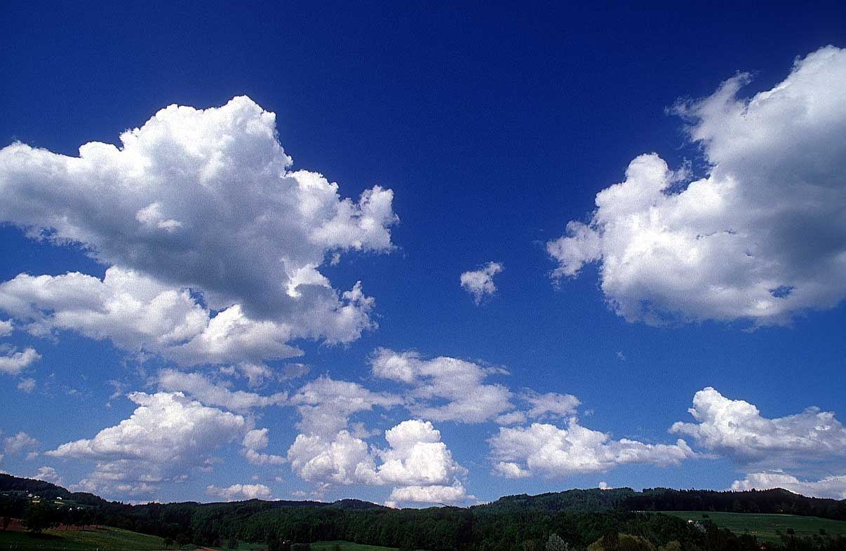
The composition of mixtures varies
This makes a mixture different from a compound. Compounds always have the same composition, whereas the composition of mixtures varies.
Example: The air

Slide 4
Mixtures can be separated into pure substances
Mixtures
Two or more pure substances

Slide 5
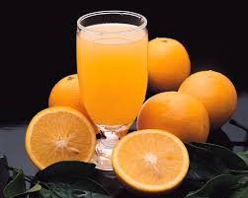
Heterogeneous Mixture
A mixture containing regions with differing properties. A mixture that does not blend smoothly throughout and in which the individual substances remain distinct.

Slide 6
Homogeneous Mixtures
A mixture that has a constant composition throughout
Homogeneous mixtures referred to as solutions. Solutions can be an any state of matter.
Example:
Liquid → Salt Water
Gas → Air in a scuba tank
Solid → Alloy

Slide 7
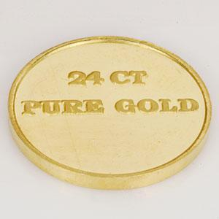
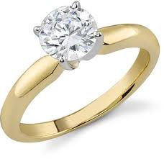
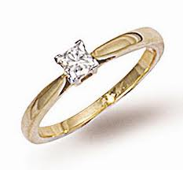
Alloy
An alloy is a mixture of elements that have metallic properties.
12 Carat Gold Ring
18 Carat Gold Ring

Slide 8
Separating Mixtures

Slide 9
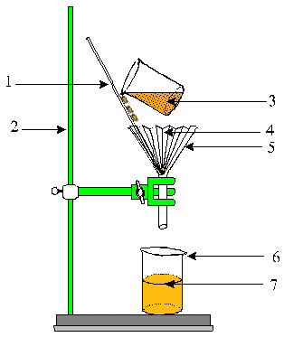
Filtration
Separation of a solid from a liquid by using a filter paper

Slide 10
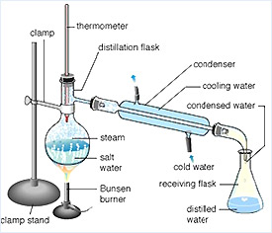
Distillation
A separation process that depends on the different boiling points of the substances.

Slide 11
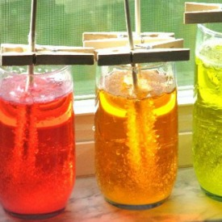
Crystallization
A separation technique that results in the formation of pure solid particles of a substance from a solution containing the dissolved substance.

Slide 12
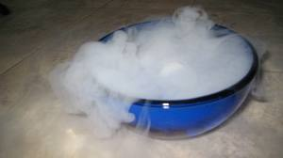
Sublimation
Mixtures can be separated by a process where a solid changes into a water without melting.

Slide 13
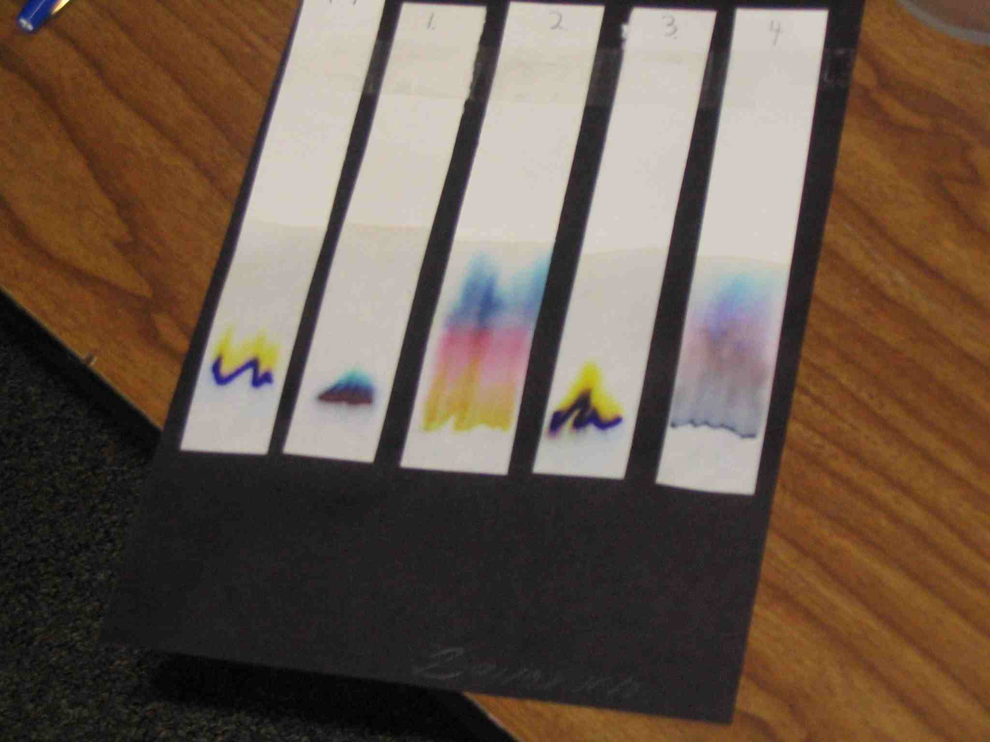
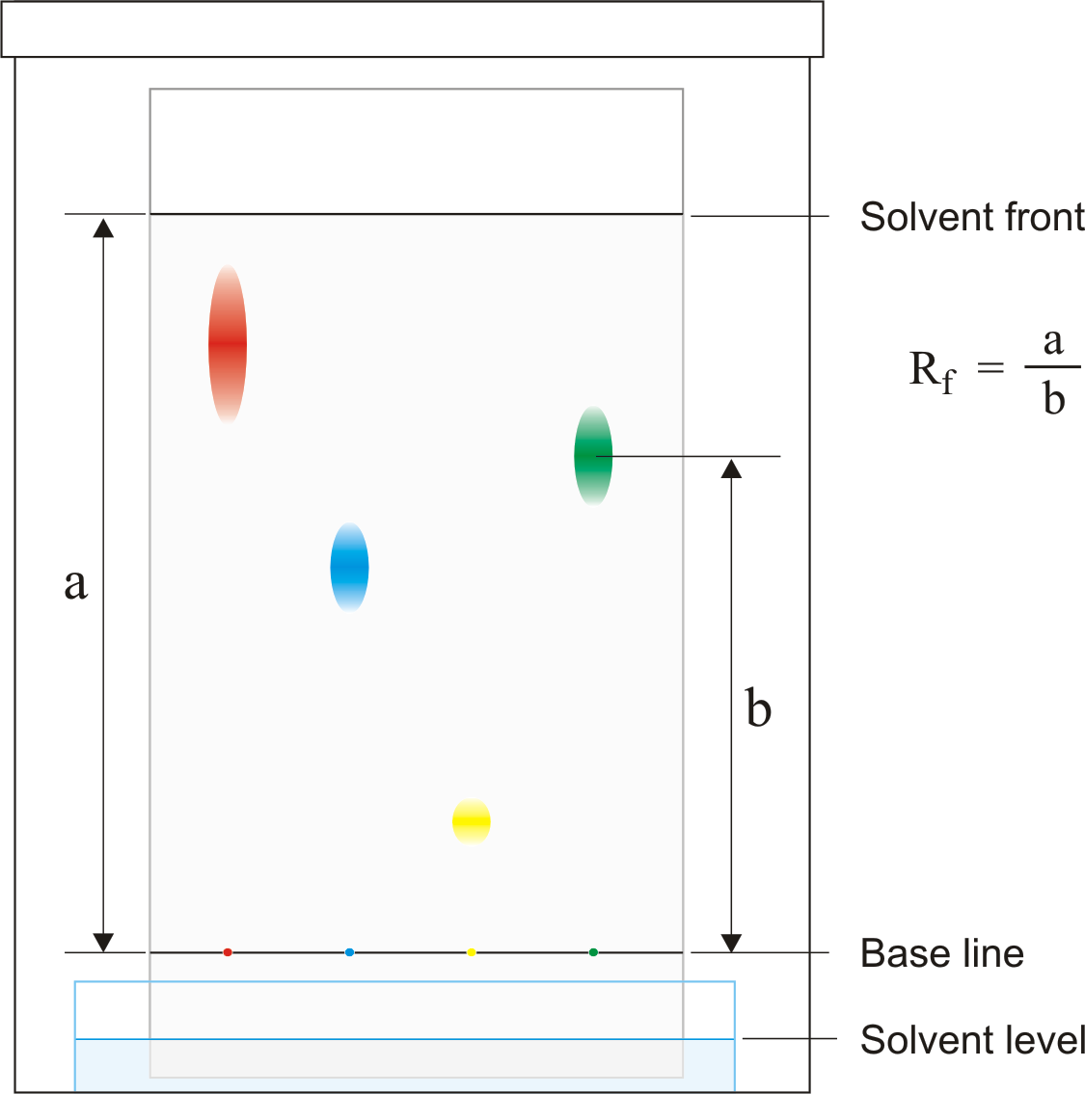
Chromatography
A technique that separates the components of a mixture dissolved in either a gas or a liquid (called the mobile phase) based on the ability of each component to travel or to be drawn across the surface of a fixed substrate (called the stationary phase).

Slide 14
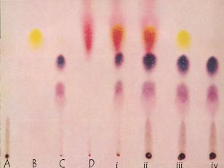
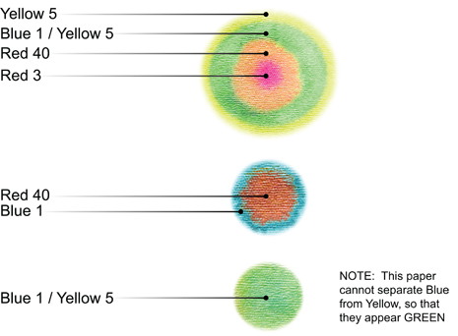

Slide 15
Elements & Compounds
Section 4

Slide 16
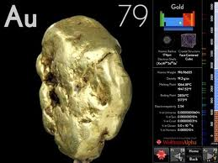
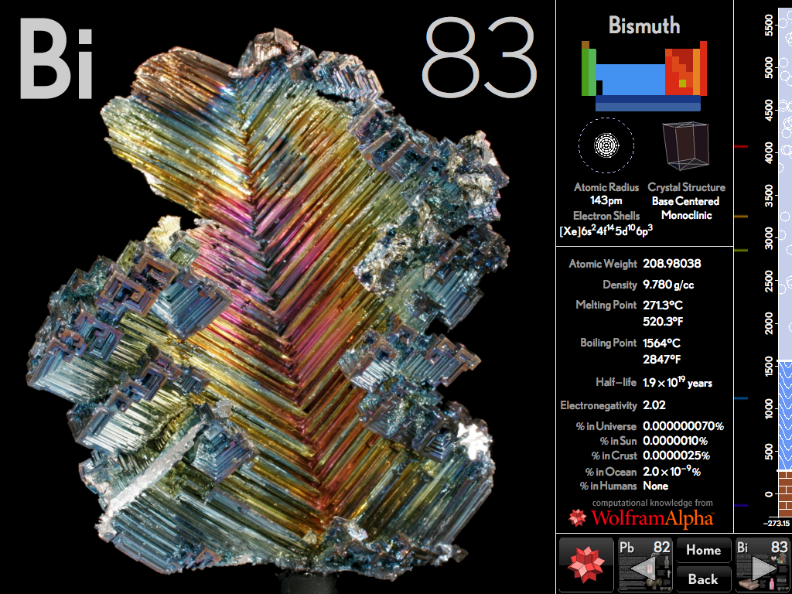
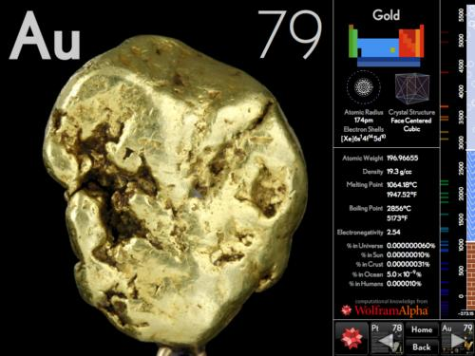
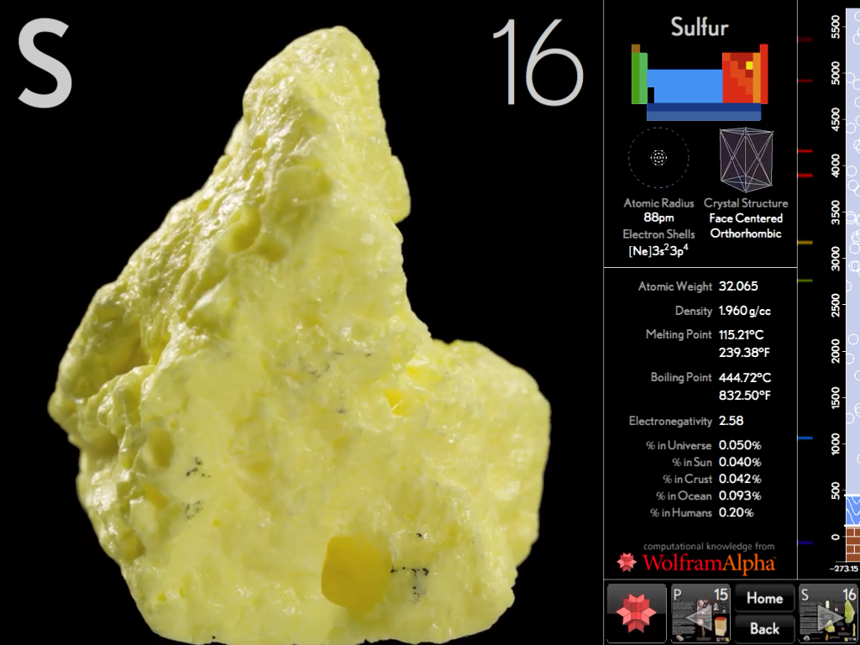
Elements
Elements are pure substances that cannot be separated into simpler substances by physical or chemical means.

Slide 17
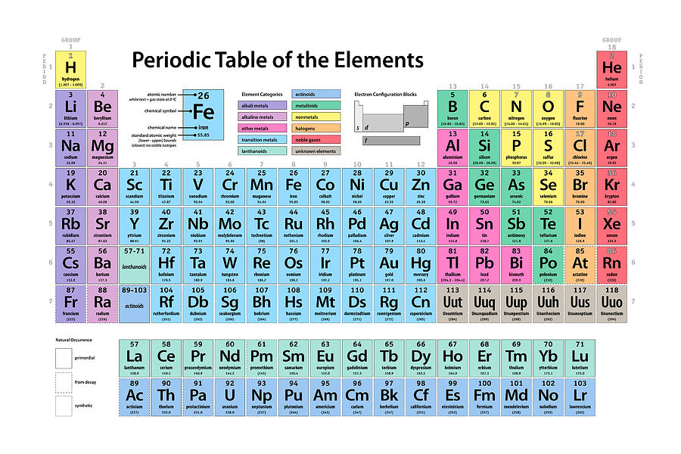
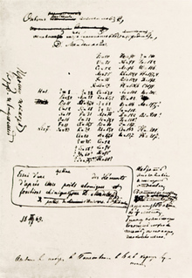
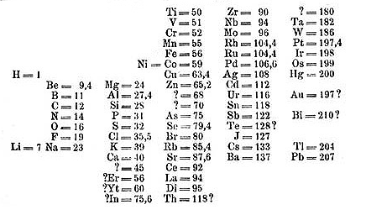
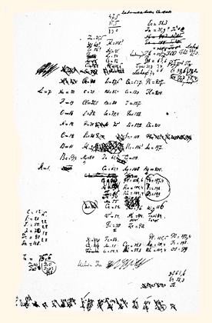
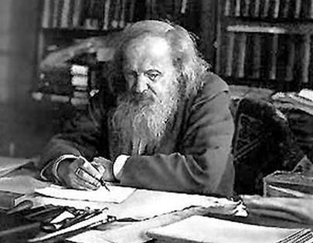

Slide 18
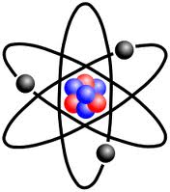
Atoms
Matter is composed of tiny particles, which we call atoms.

Slide 19
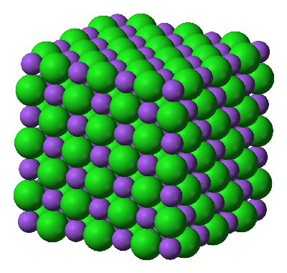
Compounds
Compounds are made up of two or more different elements that are combined chemically.
Most matter in the universe exists in the form of compounds.
Compounds always have the same composition
A Salt (NaCl) Molecule

Slide 20
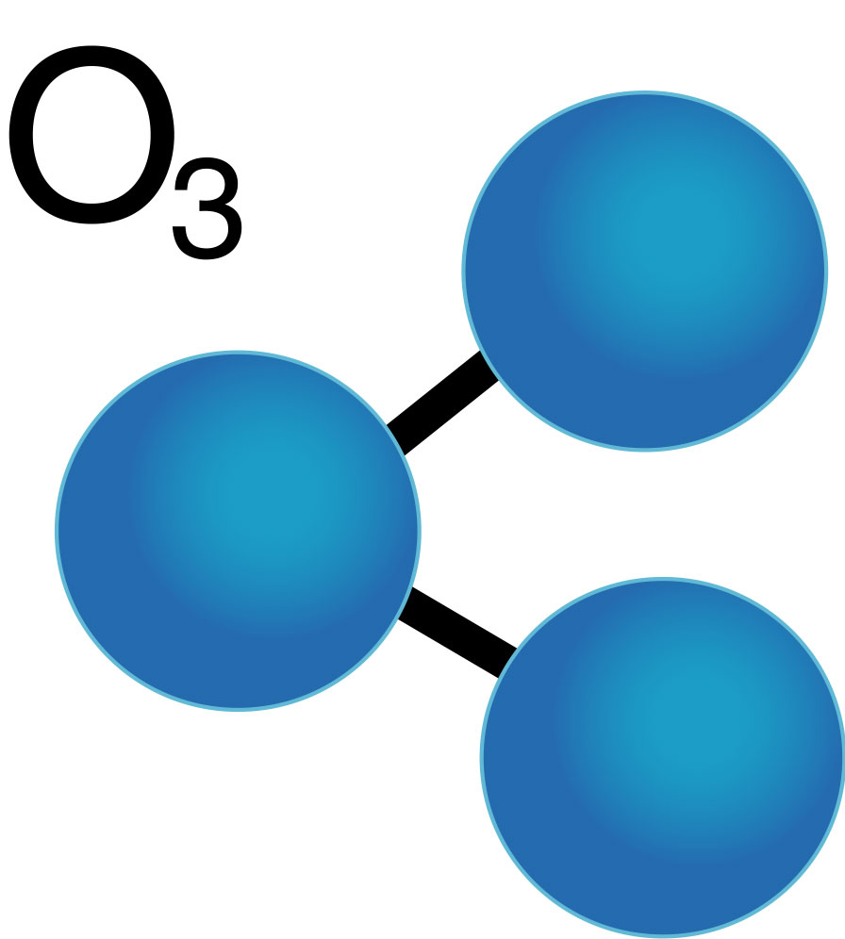
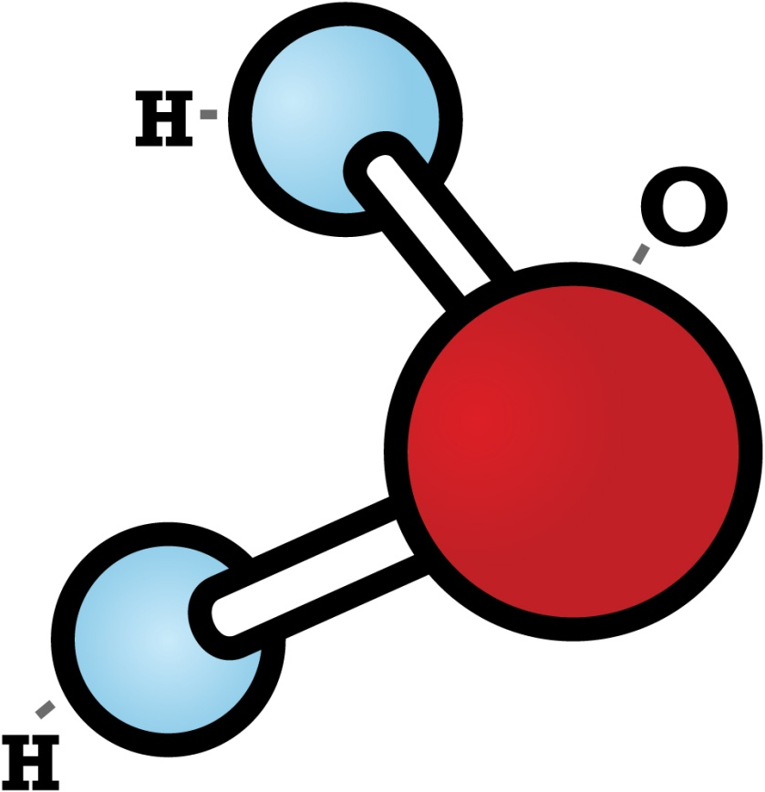
Molecules
A molecule is made up of atoms that are “stuck” together.
For example: A glass of water contains a huge number of molecules packed closely together.
Notes:
What Is the Difference between a Molecule and a Compound?
Actually, a compound is a type of molecule. A molecule is formed when two or more atoms of an element chemically join together. If the types of atoms are different from each other, a compound is formed. Not all molecules are compounds, since some molecules, such as hydrogen gas or ozone, consist only of one element or type of atom.

Slide 21
Law of Definite Proportions
States that a compound is always composed of the same elements in the same proportion by mass, no matter how large or small the sample.
The mass of the compound is equal to the sum of the masses of the elements that make up that compound.

Slide 22
Percent by Mass
The relative amounts of the elements in a compound can be expressed as percent by mass.
The percent by mass is the ratio of the mass of each element to the total mass of the compound expressed as a percentage.
$$Percent by Mass \left(\%\right)= \frac{mass of element}{mass of compound}×100$$

Slide 23
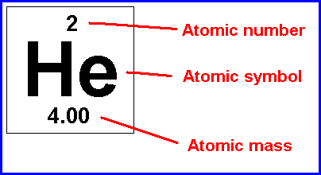
How Do I Find the Mass of an Element or Compound???
Answer: The Periodic Table
The mass of an element = Atomic Mass
The mass of a compound = the addition of each component element in the compound

Slide 24
Practice w/ Percent Mass
A 78.0g sample of unknown compound contains 12.4g of hydrogen. What is the percent mass of hydrogen in the compound?
15.9%
1.0g of hydrogen reacts completely with 19.0g of fluorine. What is the percent by mass of hydrogen in the compound that is formed?
5.0%

Slide 25
Law of Multiple Proportions
States that when different compounds are formed by a combination of the same elements, different masses of one element combine with the same fixed mass of the other element in a ratio of small whole numbers.
Ratios compare the relative amounts of any items or substances.
The ratios express the relationship of elements in a compound.

Slide 26
Analysis Data of Two Copper Compounds
Compound | % Cu | % Cl | Mass Cu (g) in 100.0 g of compound | Mass Cl (g) in 100.0g of compound | Mass Ratio $$\frac{mass Cu}{mass Cl}$$
I | 64.20 | 35.80 | 64.20 | 35.80 | $$\frac{1.793g Cu}{1 g Cl}$$
II | 47.27 | 52.73 | 47.27 | 52.73 | $$\frac{0.8964g Cu}{1 g Cl}$$

